Slide 1
BC Stats: Data Science for Policy & Operational Decisions
Matrix seminar
2020-03-13

Slide 2
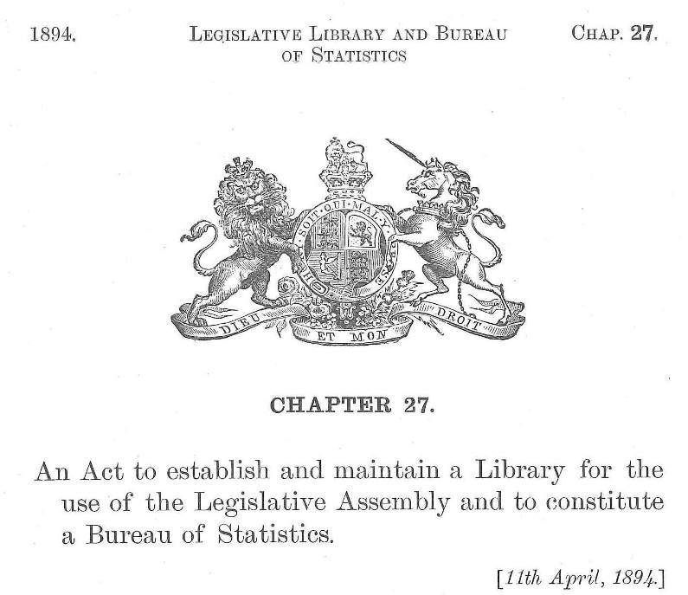
BC Stats
Notes:
BC Stats, the provincial statistics agency in British Columbia, got its start in 1894 with the passing of the Legislative Library and Statistics Bureau Act.
We provide statistical evidence to policy makers across the government, the broader public sector (such as health administrators and school boards), businesses, and the public. We do this through analysis of existing Statistics Canada data (including the Census of Canada), administrative data collected by government agencies, and surveys that we carry out.

Slide 3
What we do
“…collect, compile, compare, analyze, abstract, project and distribute statistical information respecting the commercial, industrial, financial, social, economic and general activities and conditions of British Columbia and persons in British Columbia or doing business in British Columbia”
–Statistics Act, section 5
Notes:
British Columbia Statistics Act, section 5
http://www.bclaws.ca/civix/document/id/complete/statreg/96439_01#section5

Slide 4

Notes:
The Moneyball effect
“Moneyball” (Michael Lewis’ book and the movie) tells the story of how the Oakland A’s in the early 2000’s used information to compete with other teams with much higher revenues, and the ability to hire star players. The A’s adopted an approach based on information and analysis to identify which players were undervalued in the market. Their use of data analytics gave them a competitive advantage.
This story has been repeatedly used to demonstrate the value of information and analysis in a variety of contexts.
Examples:
Ilan Mochari, “The New Moneyball—and Why it Matters for Business”, Inc. magazine
http://www.inc.com/ilan-mochari/the-new-moneyball.html
Harvard Business Review, “Moneyball and the Talent Mismatch Facing Business”
https://www.google.ca/url?sa=t&rct=j&q=&esrc=s&source=web&cd=1&cad=rja&uact=8&ved=0ahUKEwiWucSAxMTQAhXHgFQKHTpID-kQFggdMAA&url=https%3A%2F%2Fhbr.org%2F2011%2F09%2Fmoneyball-and-the-talent-misma&usg=AFQjCNHKHZmbekoYFTBmy5ToxGDMERCRrA&sig2=4gSCOqixyvR7SaBeqnzBbQ

Slide 5

Notes:
In the public sector, we hear about data and information being used to inform “evidence based policy”

Slide 6
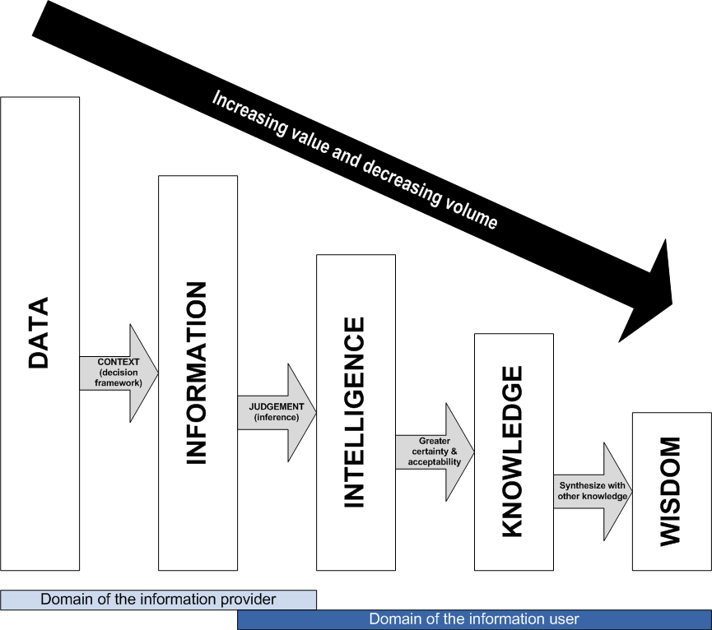
Good decisions start with
good data
Source: V.P. Barabba
Notes:
The Value of Statistical Analysis: Data to Wisdom
Source: Modified from V.P. Barabba, “Through a Glass Less Darkly”, Presidential Address at the Annual Meeting of the American Statistical Association, Aug. 7, 1990.
All organizations – government, non-profits, businesses – need better data in order to make better decisions. They are on the right—the “information users”
These decisions will lead to better outcomes and more effective use of resources
BC Stats is on the left side of the diagram – the “information provider. We collect data, compile it into information, and add analysis that turns it into intelligence

Slide 7
BC Stats: Who Are Our Clients?
Primary client groups:
BC government ministries
Statistics Canada
Other client groups:
crown corporations
public agencies and education institutions
business community & academics
public

Slide 8
BC Stats: staff
Professional researchers
Academic qualifications:
Social sciences (sociology, psychology, economics)
Natural sciences (geography, biology, astronomy)
Statistics and Computer Science
and others!
Experience in quantitative analysis, data collection
Always learning!

Slide 9
BC Stats: analysis
Techniques
Driven by information needs
Examples:
Counts and percentages
Time series analysis
Multivariate regression
Statistical modelling & machine learning
Software tools
Excel, SPSS, STATA, eViews, R
especially R
Notes:
The statistical techniques we use in a particular case depends on what the information needs are.
Sometimes it’s as simple as counts and percentages.
In other cases we’re doing time series analysis, including techniques such as trend analysis and seasonal adjustment
And sometimes we’re deep into multivariate methods, such as regression, factor analysis, and modelling techniques (econometrics, structural equation modeling)

Slide 10
BC Stats: data sources
Statistics Canada
Administrative records
Surveys
Web: E-mail invitation with internet software for data collection
Phone: under contract by private companies.
Paper, by mail: BC Government’s mail service.
Notes:
Statistics Canada has a wealth of data already available that provides insights and information that can inform policy decisions. We will be looking deeper into that topic later in the presentation.
BC Stats also has information sharing agreements with various public agencies that allows us access to administrative records that can be used for statistical purposes. Two examples:
Tax revenue information from hotels and other accommodation industry businesses provides a proxy for spending by tourists on hotel rooms
Information from BC Hydro on the number of residential accounts provides a proxy for the number of households in an area, which is used for population estimation
Where data don’t already exist, BC Stats carries out surveys. We do this in three modes – web, phone, and on paper.
Surveys are most effective where we have access to underlying administrative records. These records provide us with valuable information, starting with names of program participants and their contact information, which facilitate contacting people. And those admin records can also contain demographic information that we can use for analysis, without having to add more questions for the respondent to answer (reducing respondent burden)

Slide 11

What we do
Notes:
This model is from Hadley Wickham and Garrett Grolemund, _R for Data Science_, r4ds.had.co.nz

Slide 12
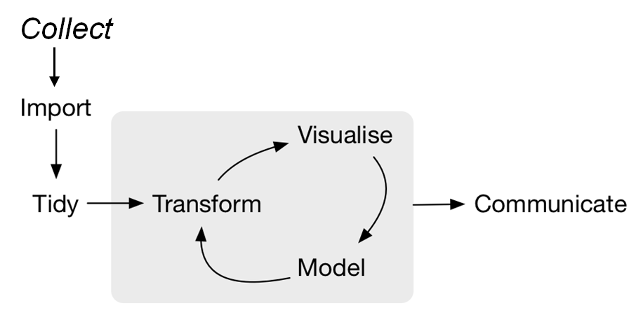
What we do (revised)
Notes:
At BC Stats we also collect data, often through surveys but also from administrative sources.

Slide 13
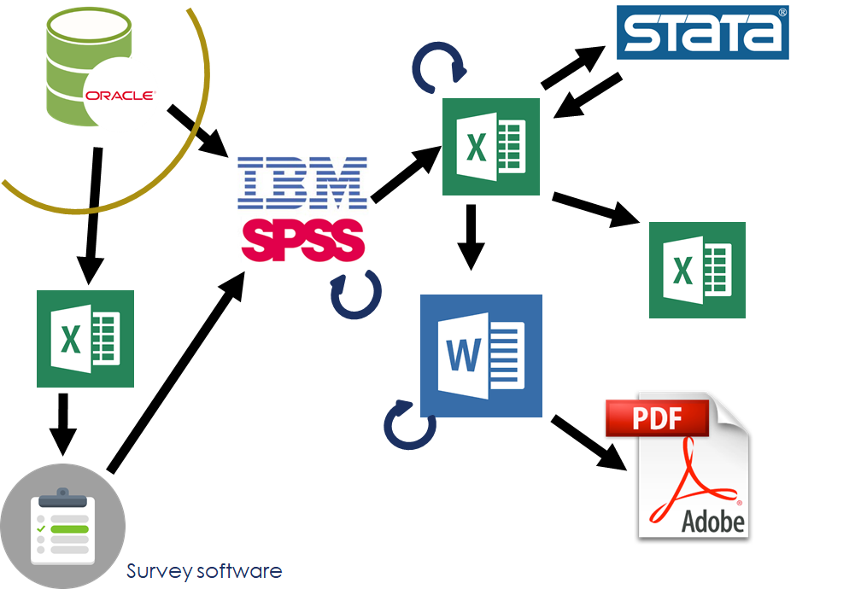
Workflow: past

Slide 14
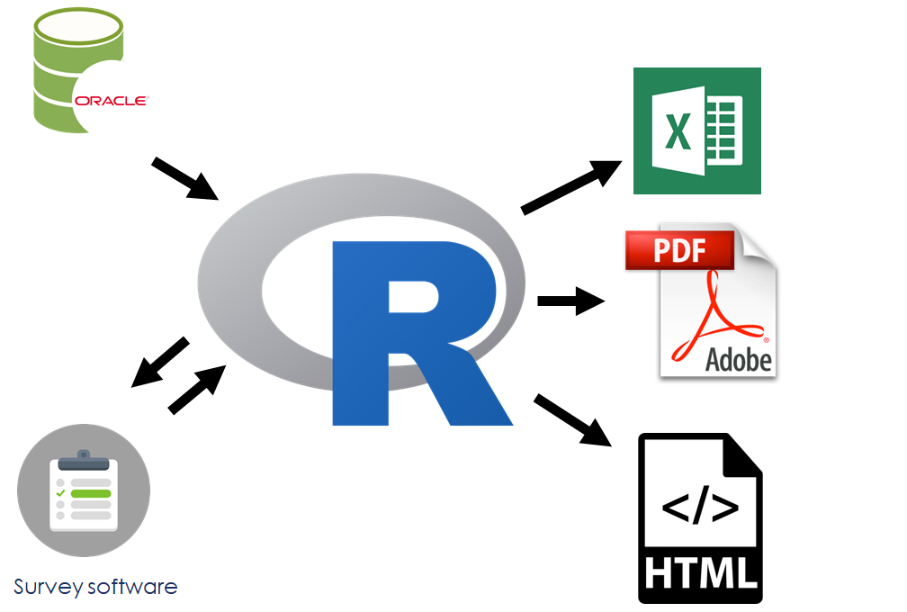
Workflow: present

Slide 15

Notes:
This is a European robin—an old world flycatcher

Slide 16

Notes:
This is a North American robin—a thrush. A completely different sort of bird, with the same name.
It seems that similarly, there are two types of “data scientist”.
For more on this, see “Same name, different bird” by Martin Monkman https://martinmonkman.com/post/2019-06-02_same-name/

Slide 17
What we do (revised)

Slide 18
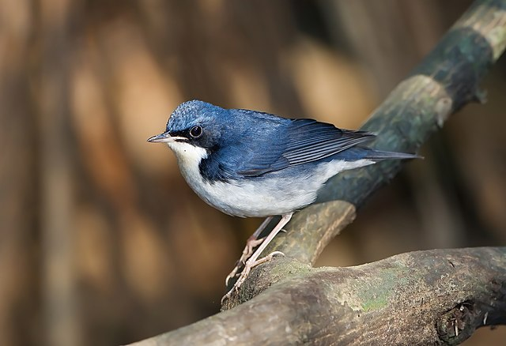
Notes:
This is also a robin—so perhaps it’s not a very good analogy at all!

Slide 19
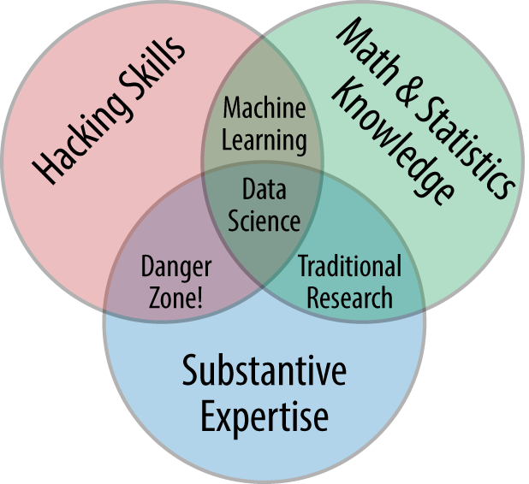
Notes:
The data scientists at BC Stats live right in the middle of the Venn diagram, having come from areas of substantive expertise and math & stats, with added computer science / programming (the hacking skills)
Drew Conway, “The Data Science Venn Diagram” (2013-03-26)
http://drewconway.com/zia/2013/3/26/the-data-science-venn-diagram

Slide 20
Enhancing Workflow and Outputs at BC Stats
Notes:
Work at BC Stats operational, busy to meet timelines – not reviewing existing processes
My role has allowed me review and make enhancements
aimed to shorten timelines
reduce costs
increase value to our clients
Touch on two projects from different program areas at BC Stats.

Slide 21

Work Environment Survey Reporting
BC Stats runs several Work Environment Surveys each year
Clients include BC Public Service, crown corporations, post-secondary institutions and school districts
The survey asks employees about their day-to-day work, physical environment and tools, development and performance, and the people they work with
Summarize results in excel workbooks broken out by work groups or demographic groups
Notes:
The first project – Work environment survey reporting
BC Stats runs several a year
BC Public Service – largest client – surveys nearly 30,000 employees every two years
Other clients include LDB, Camosun College, Sooke School
Survey employees on day-to-day work, their physical environment and tools, their development and performance, the people they work with
Several types of reporting
Focus on Excel Workbook – continually requested by clients – summarize survey results by desired groups e.g., divisions and branches, etc.

Slide 22




Work Environment Survey Reporting
Process:
Raw data
Final formatted report
Unformatted summary tables
Notes:
Original process for producing these excel workbooks:
Extract survey
Data processing in SPSS
Output unformatted summary tables and raw data to excel
Send raw data to IT
Get back the final formatted report in excel
Finally compare numbers to our results – Often mistakes, need to rerun final steps

Slide 23
Work Environment Survey Reporting
Issues:
Run by different employees at BC Stats
Minimal standardization
Lack of version control
Report generation done by an individual IT resource for all projects
Notes:
Some issues:
Several surveys run at same time by diff employees
min standardization – Info provided to IT was inconsistent
lack of version control – overarching edits were not captured
Only one IT resource
bottle neck
project dependent code would sometimes be copied over to another project, and created mistakes in the final numbers.

Slide 24
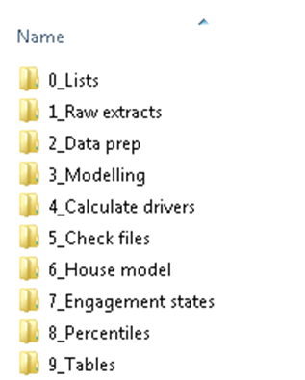
Work Environment Survey Reporting
Tackling Standardization/Version Control:
Template folder structure
Notes:
Tackling standardization/version control:
Templated folder structure:
Copied into new project folder
Necessary files to run program
Instructions for each step
uniform process across all projects.
overarching edits made here and carried through to each project
Easy to fill in on a project to cover sick leave/vacations if necessary

Slide 25
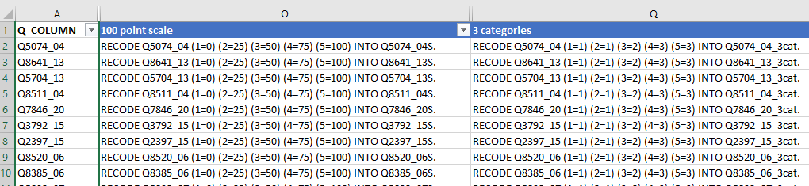
Work Environment Survey Reporting
Tackling Standardization/Version Control:
Template SPSS syntax and Excel “syntax generator” files with updatable formulas
Notes:
Data manipulation done in SPSS often with drop down menus – not easily reproducible
Added SPSS syntax files to the templated folders
Diff Qs across projects – included excel “syntax generator” files
Ex:
Paste in Q ids; formulas spit out the SPSS syntax – Recode to 100pt, 3cat
Positive feedback on standardization from IT partner – smoothed running the reports in 10yrs

Slide 26
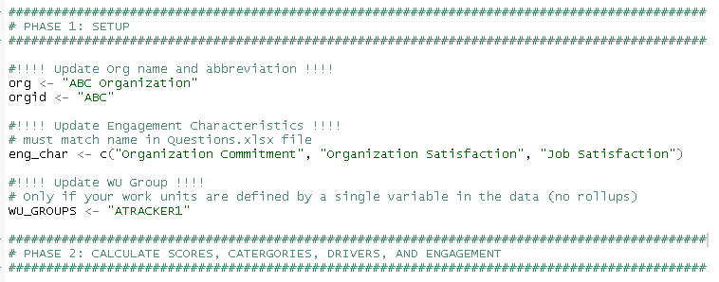
Work Environment Survey Reporting
Tackling IT dependency:
Used R to generate the final Excel reports
Inputs: SPSS dataset, Excel “syntax-generator” file
Customization: from inputs and at the top of the R script only
Notes:
After standaridization – Focused on bottleneck of IT
In 2018 went from 1 to 0 IT
R!
Not replace the bottleneck myself – code to require minimal alterations that could be used across all WES projects
Inputs – SPSS datafile, inputs of Excel “syntax generator”, i.e. QIDs
Additional customization required upfront, as shown

Slide 27
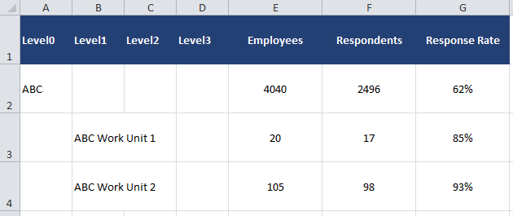
Work Environment Survey Reporting
Output – Response Rates:
Notes:
Snippets of the output generated by R
Response Rates tab

Slide 28
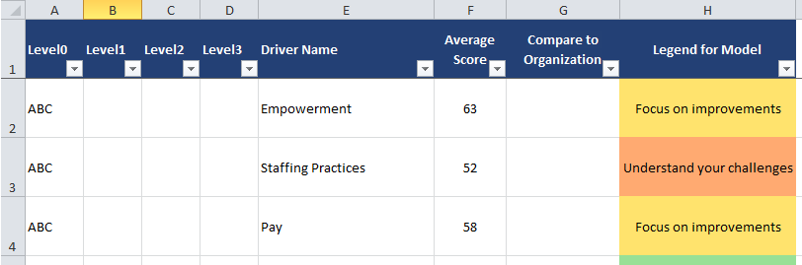
Work Environment Survey Reporting
Output – Engagement Model:
Notes:
Engagement model tab
All of the formatting is done in R:
Filters
freeze panes
column spacing
colour coding of the Legend for Model column, which is based on the average scores.

Slide 29
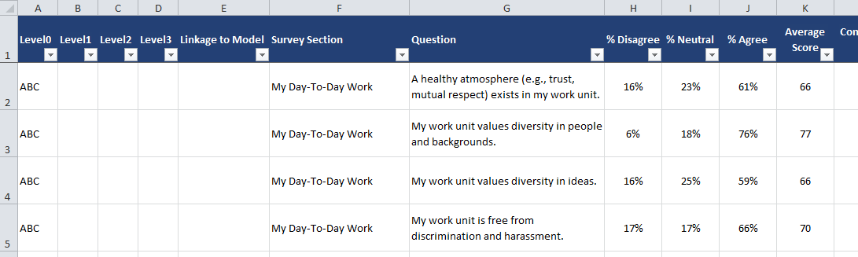
Work Environment Survey Reporting
Output – Question Scores:
Notes:
Finally, all survey question results:
Percentages of agreements
Average scores

Slide 30

Work Environment Survey Reporting
Workflow enhancements:
Clear direction and consistency across projects run by different people
No longer reliant on one person to produce all reports
New Process:
Final formatted report
Notes:
The impact of these changes:
Increasing the standardization/version control with the templated folders and syntax files
clear direction on how to produce these reports and consistency across projects that are run by different people
2. The R programs to produce the final formatted excel reports
completely removed the bottleneck in the process
reduced some existing steps, such as having duplicate copies of the raw data
New Process: survey data -> SPSS -> R -> final report

Slide 31

Infoline – Retail Sales Reporting
Infoline is a free information bulletin that presents a variety of key economic indicators for BC
Published as an enewsletter and website
One such topic is Retail Sales
Notes:
Second project – Retail Sales reporting on Infoline
a free information bulletin – indicators such as GDP, CPI, Labour Force stats, etc.
enewsletter and on BC Stat’s website
One such topic is Retail Sales

Slide 32
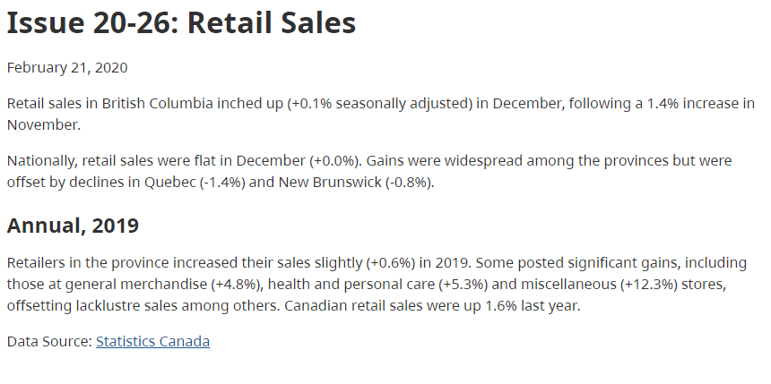
Infoline – Retail Sales Reporting
https://www2.gov.bc.ca/gov/content/data/statistics/infoline/infoline-2020/20-26-retail-sales
Notes:
Latest issue on Retail Sales from the BC Stas Infoline website
Highlights BC, national, stand out provinces
Dec data – this issue includes yoy change for sectors – eg. Health and personal care
Data provided by Statistics Canada

Slide 33
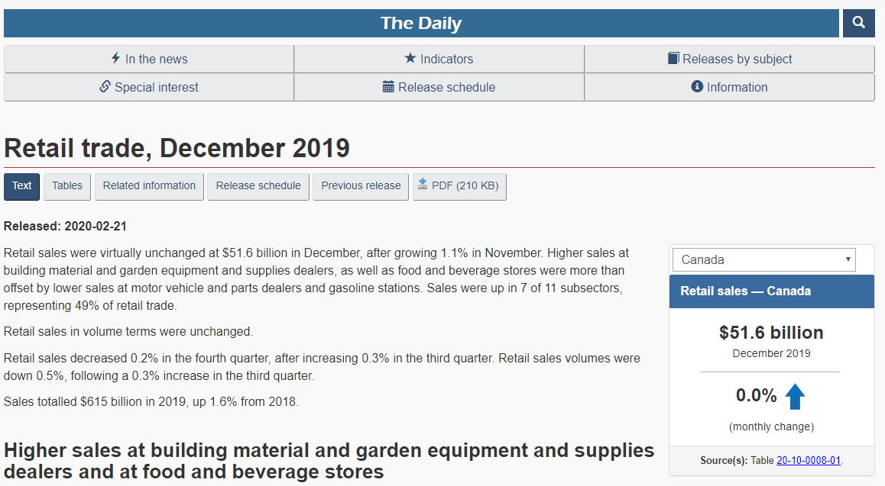
Infoline – Retail Sales Reporting
https://www150.statcan.gc.ca/n1/daily-quotidien/200221/dq200221a-eng.htm
Notes:
The Daily
national lens
drop down for provinces
tables to view and download the data used to populate the Infoline release

Slide 34
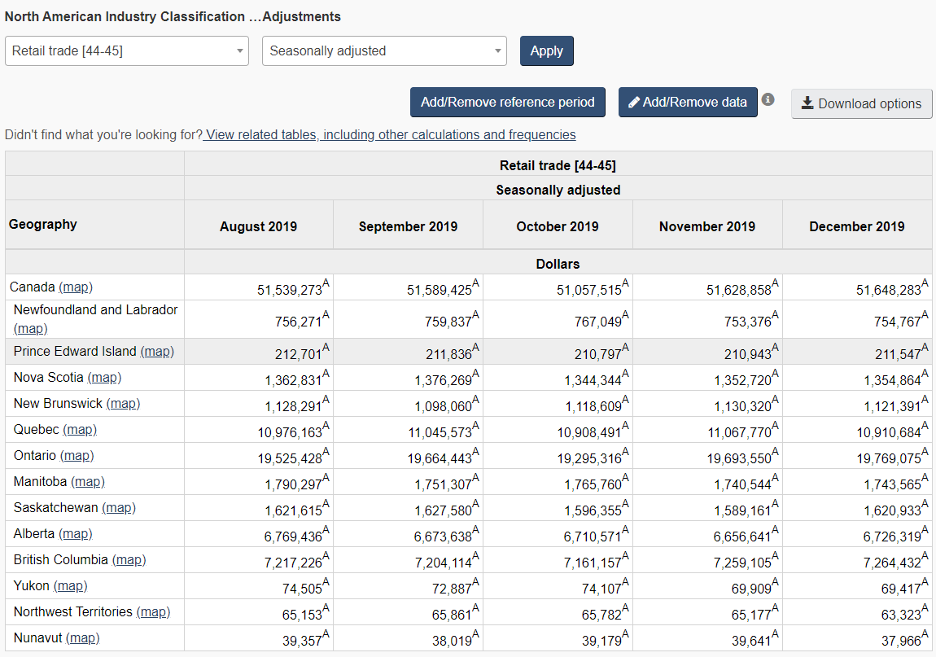
Infoline – Retail Sales Reporting
https://www150.statcan.gc.ca/t1/tbl1/en/tv.action?pid=2010000801
Notes:
Total retail sales by province/Canada
Can calculate mom change from here and write a quick blurb about trends

Slide 35
Infoline – Retail Sales Reporting
Upgrades:
Add value to BC business owners
Reduce the monthly work of an analyst
Notes:
Process is ok – many topics in Infoline adds up
Some possible upgrades include:
Add value
Reduce monthly work

Slide 36
Infoline – Retail Sales Reporting
Adding value to BC business owners / Reducing monthly work of an analyst
Present data in an online dashboard with visualizations
https://bcstats.shinyapps.io/RetailSalesApp/
Includes code to download and manipulate the Stat Can data
RStudio and shinyapps.io make it easy to publish the latest data
Notes:
Online dashboard in R
Demo website
Easy to publish latest data

Slide 37
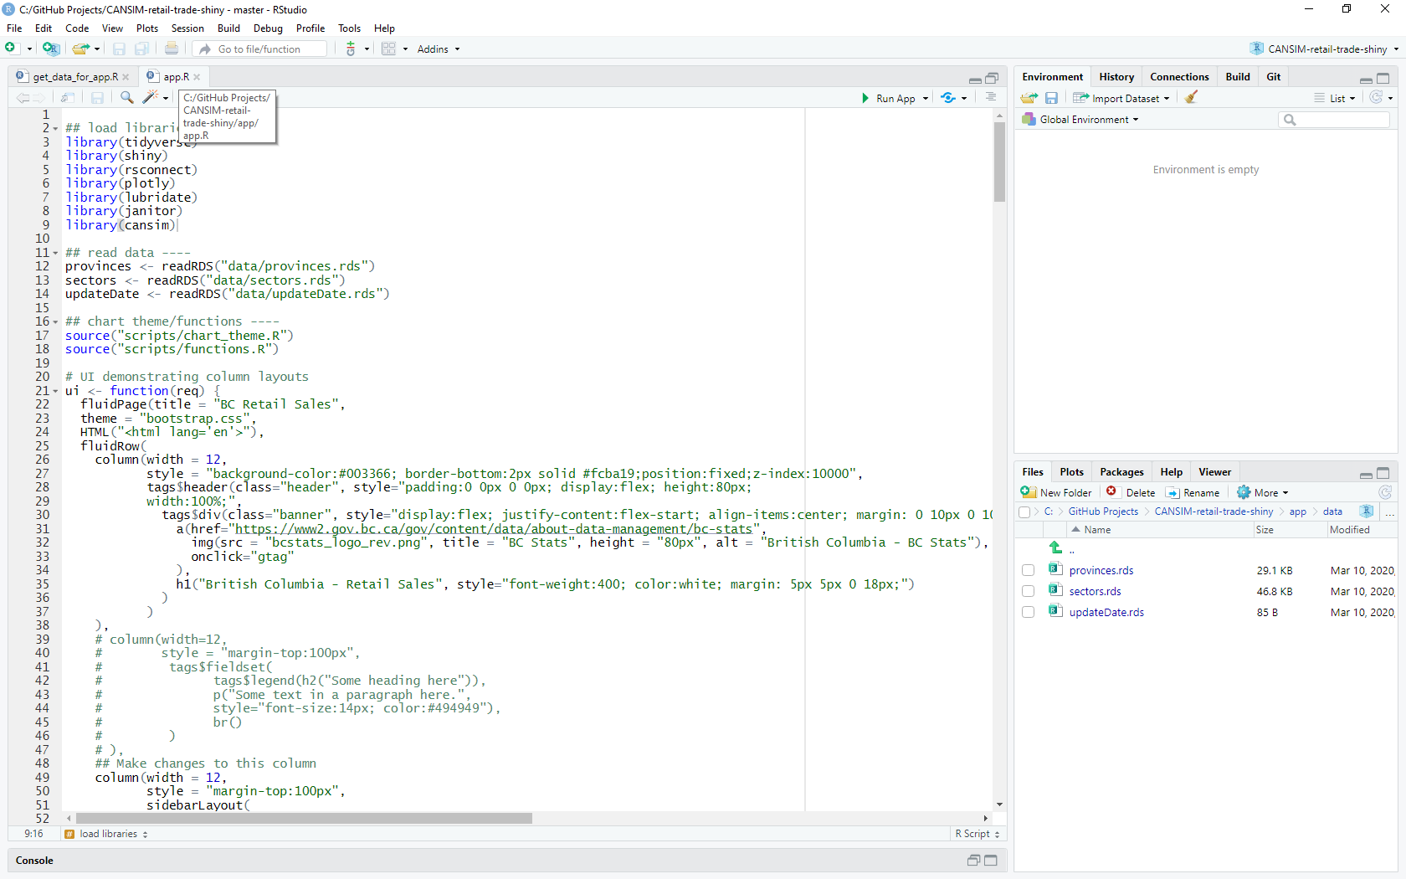
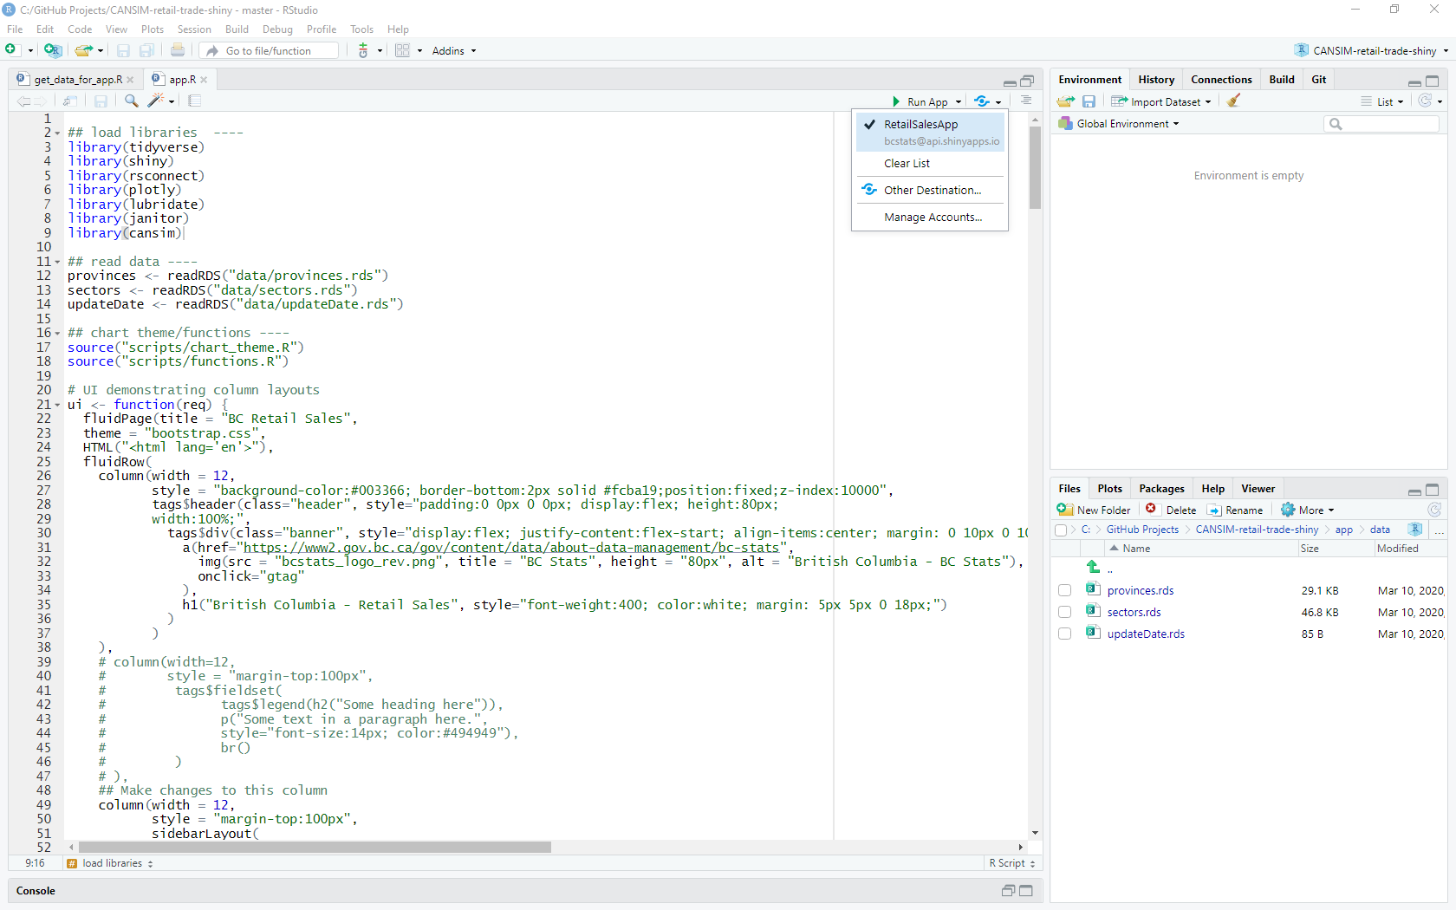
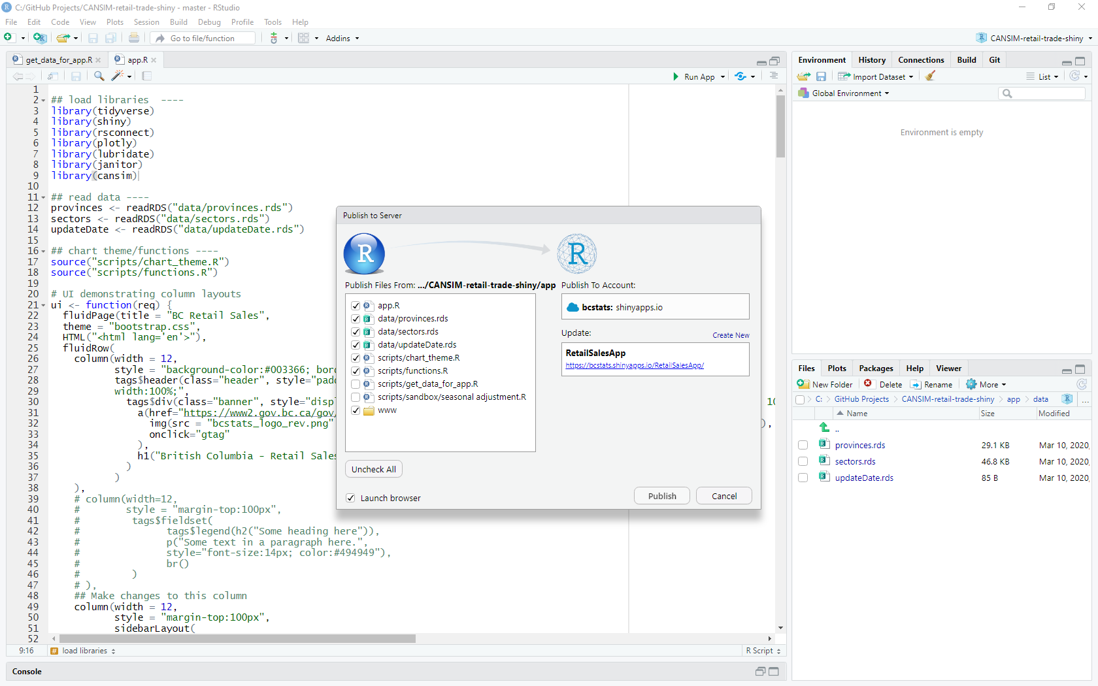
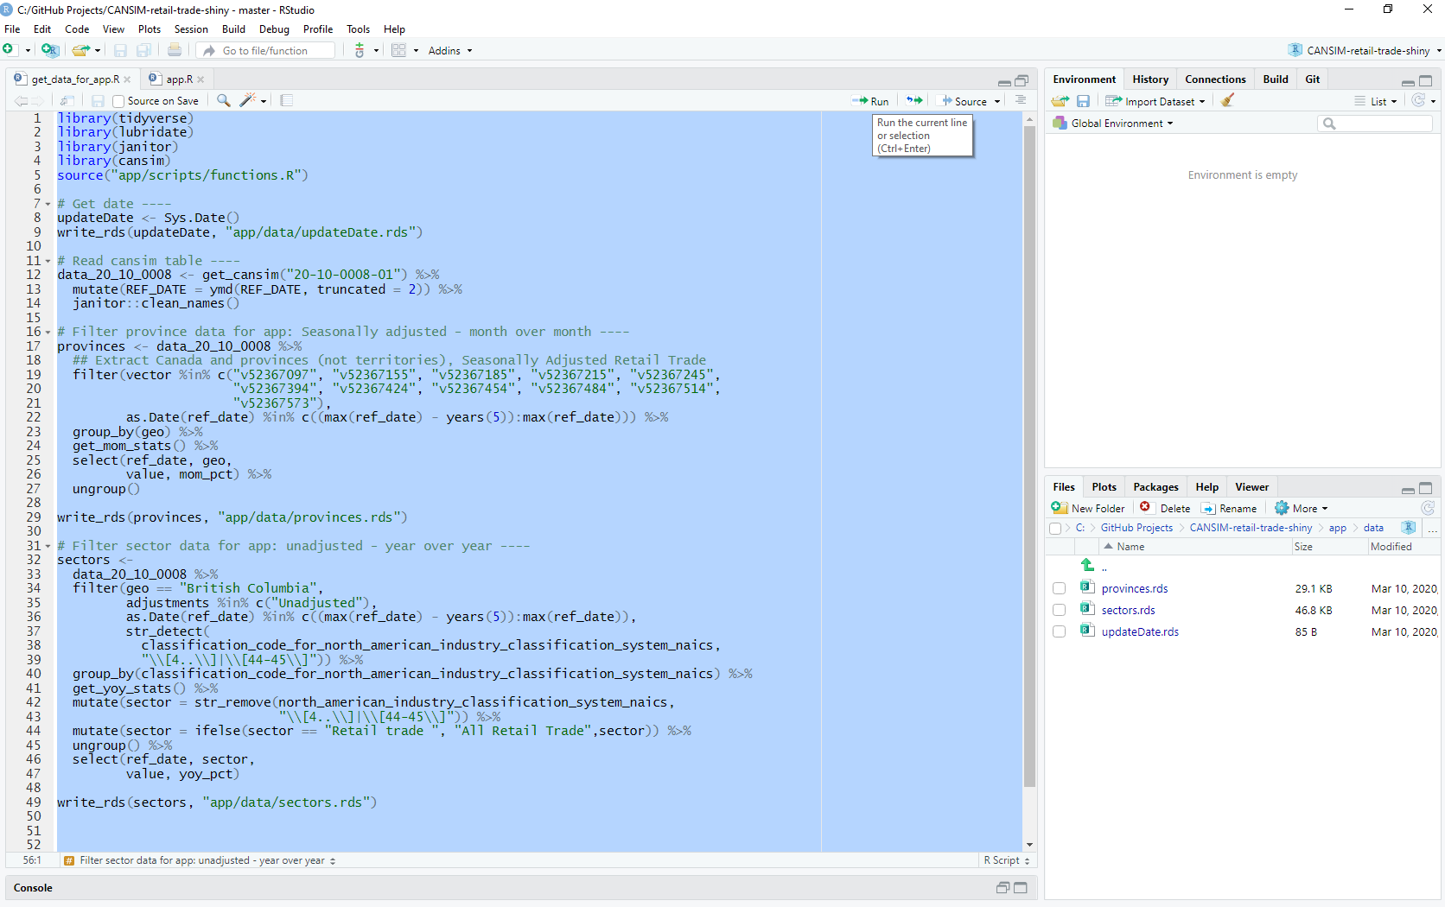
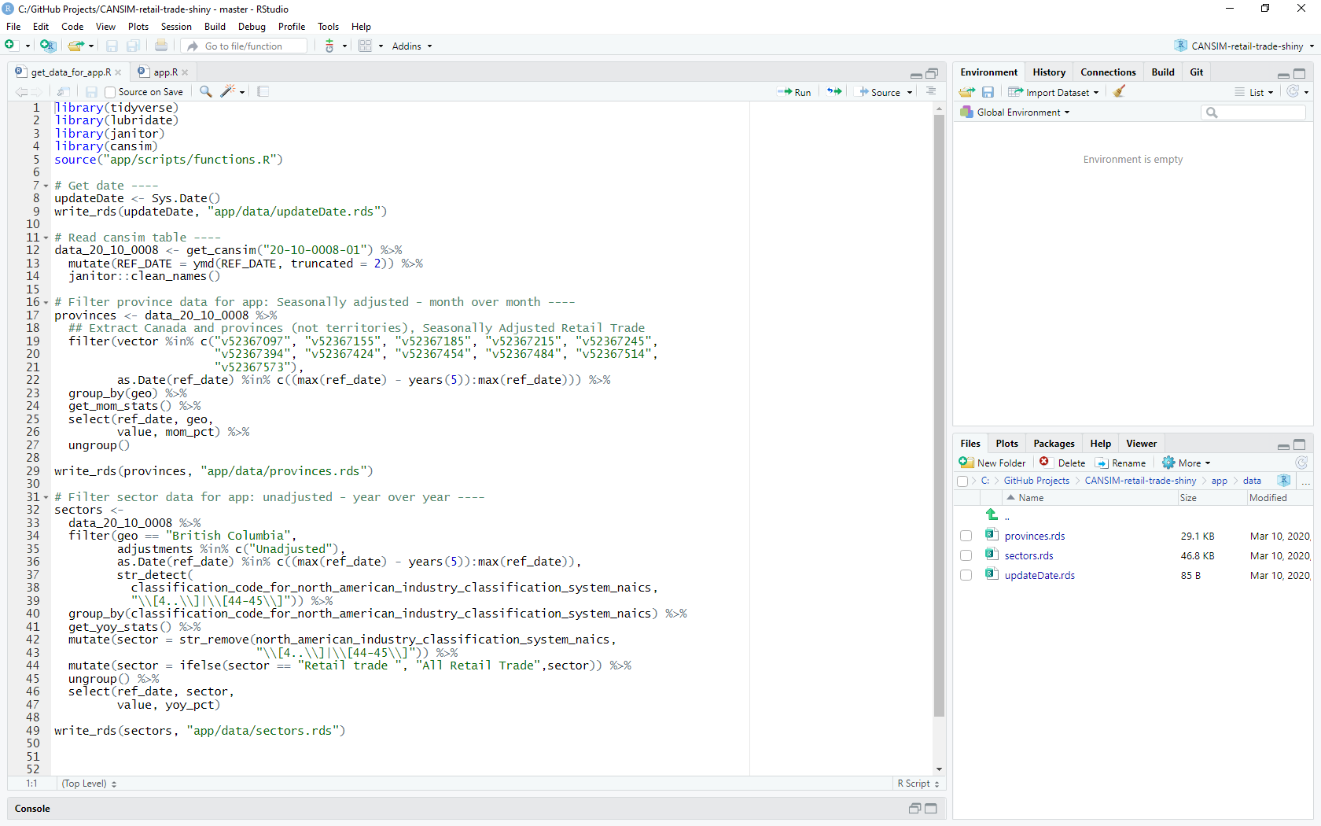
Notes:
Open RProject in RStudio
Open get_data script
Select and run all
cansim package reads data directly from stat can
Calculate mom and yoy stats
Open app script
Click publish

Slide 38
Infoline – Retail Sales Reporting
Next Steps:
Set up a scheduled task to publish the monthly updates
Apply seasonal adjustments to the retail sales totals by sector
Extend the dashboard to include other Infoline indicators (e.g., Wholesale and Manufacturing Sales)
Notes:
Work in progress – not replaced current approach
Next steps:
scheduled task to publish the monthly updates
applying seasonal adjustments to the retail sales total by sector – not provided by stat can
Add other Infoline indicators to dashboard

Slide 39
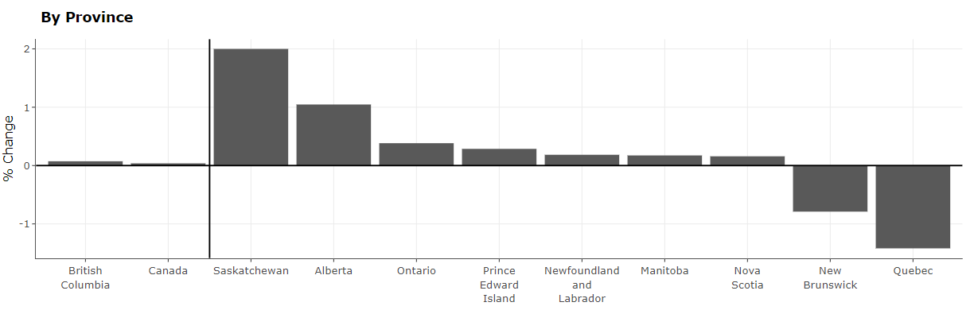
Summary
Project 1: Improved workflow of the Work Environment Survey reporting
Project 2: Enhanced the Retail Sales reporting output
Final formatted report
Notes:
Presented two projects
First improved workflow of WES reporting
Second enhanced output of Retail Sales reporting

Slide 40
BC Stats: Two Data Science Projects Using R
Notes:
Hi, I’m Julie Hawkins. I’ve been with BC Stats since 2001.

Slide 41

Data Science, R & BC Stats: Two Projects
How does BC Stats use R to solve data science problems?
Determining top drivers in small organizations
Adjusting sub-provincial population estimates by age & sex in BC
Notes:
We’ve just seen a couple great examples of using R to solve data science problems at BC Stats. Now, I’ll show a couple more.
- The motivations behind the use of R (including reproducibility and other strategies to make our workflow more robust);
- Examples of the kinds of problems that a data scientist in the public service confronts; and,
- How those problems have been tackled.
R projects I have worked on include survey analysis & reporting; data modelling; (re)writing programs from Excel, SPSS, APL, etc. into R:
automating or improving co-workers’ programs (e.g., running the population app in Shiny, determining the top drivers of engagement from many possibilities, reporting on cumulative monthly housing data)
writing an R replacement of outdated/expensive/confusing software (e.g., structural equation modelling in R instead of SPSS AMOS, raking population estimates in R instead of APL)
auto-suppressing data results to maintain respondent confidentiality
conducting survey data analysis with custom functions from basic table creation (e.g., New Job Survey data analysis, BC Knowledge Development Fund Report) to an online dashboard or report generation (e.g., Elections BC Voters’ List Quality)
teaching opportunities (e.g., creation of in-house R package tutorials, presentation at the inaugural BCGov useR! Workshop)
Image by Getty Images/iStockphoto, creator dottedhippo; https://www.istockphoto.com/ca/photo/blue-3d-person-with-question-marks-around-the-head-gm645357396-116980443

Slide 42
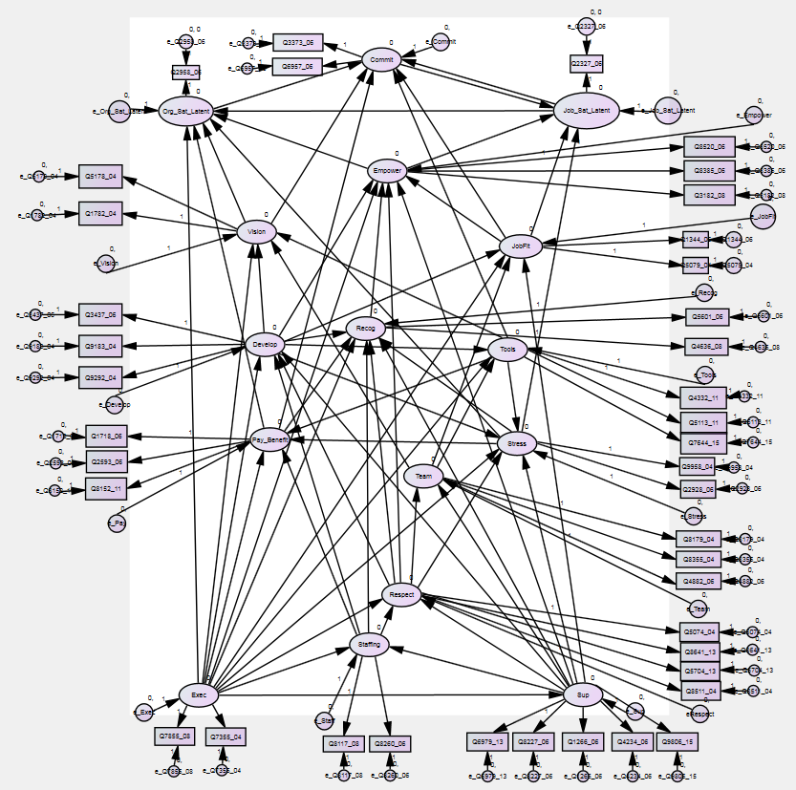


Determining Top Drivers
Notes:
For the Work Environment Survey that has already been mentioned today, we conduct Structural Equation Modelling (SEM) to show the impacts of various workplace attributes on employee’s engagement.
In the BC Public Service, we get survey responses from tens of thousands of employees.
*** CLICK ***
This plays very nicely with SEM, or what we call “the spiderweb”.
People image: Getty Images/iStockphoto, by creator aelitta; https://www.google.com/search?q=lots+ppl+istockphoto-645261598-612x612&client=firefox-b-d&source=lnms&tbm=isch&sa=X&ved=2ahUKEwi9v9jX6IHoAhUO7J4KHX54CMwQ_AUoAXoECAgQAw&biw=1536&bih=750#imgrc=0V7d8rPgfdvDlM

Slide 43
Determining Top Drivers in Small Organizations
Problem
We cannot conduct Structural Equation Modelling (SEM) on small organizations.
We can conduct a series of regressions to analyze response patterns to assess how well the employee engagement model represented employees’ experiences and whether or not drivers impacted employee engagement the same was as seen in other organizations.
But this can quickly become a lot of work!
Notes:
So, what’s the problem? We run the Work Environment Survey for many organizations. Our Employee Engagement Model requires ~400-500 responses to conduct SEM.
*** CLICK 1 *** However, many of these organizations have too few employees to support full-fledged SEM. Or, we may want to confirm model relationships on multiple smaller sub-groups (e.g., work units) within large organizations.
*** CLICK 2 *** so… we will conduct smaller simpler analysis to confirm data relationships
*** CLICK 3 *** but that can get big fast!

Slide 44
Determining Top Drivers in Small Organizations
Solution
Automate multiple regression analyses, summarize and output the resulting statistics in a concise and reproducible format
“What are the most important (“top”) drivers for any given work unit?”
Notes:
How do we handle this?
*** CLICK *** we use R to automate the analyses, summarize results from reliability tests, and many multivariate regressions, and then output the key info
And, it’s all reproducible
Now, we can answer the question: What are the most important (top) drivers for any given work unit?
** QUICK ASIDE: What is a driver?**

Slide 45
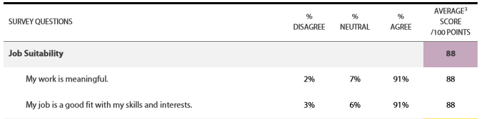
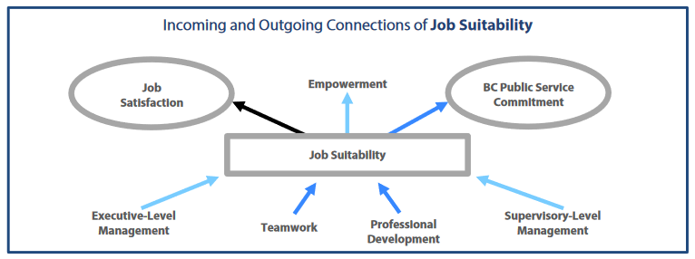
What is a Driver?
Notes:
In our Employee Engagement Model, we have “drivers” (aka, factors, latent variables, etc.). Each driver is made up of two to five underlying survey questions.
For example, Job Suitability is derived from two questions.
*** CLICK *** With SEM, we establish the pathways amongst drivers. Without SEM, we want to confirm these relationships that we know exist (from our BCPS model), and we want to find the most important ones.
* Back to our project *

Slide 46
Determining Top Drivers in Small Organizations
** R project **
Load packages and custom functions
Get input file
Set organization-specific values
Call custom functions within a single RUN_ANALYSIS script
Summarize results, and save output as csv
Notes:
An aside about R projects:
Everything is in an R project, which is a very useful way to keep your work together.
The main benefit of using a project (as opposed to a bunch of unlinked scripts/RMD files and data) is that importing data is much easier: a project pre-defines a relative working directory (the place R looks for files) in the folder containing the .Rproj file.
If NOT R project, you need to set working directory -> long path names that may change over time and that are sensitive to the computer and it’s operating system (e.g., PCs and Macs use different slashes in file paths; different computers may have different drives, etc.). This will save time for you down the road or others who may need to reproduce your work.
Another benefit is that R projects can allow for version control and collaboration (i.e., GitHub).
*** CLICK *** To address the problem I just mentioned, I follow 5 steps.

Slide 47
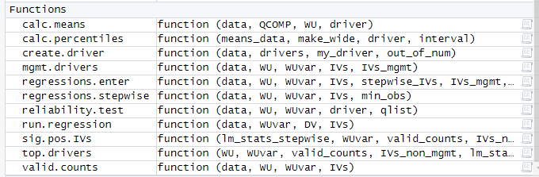
Determining Top Drivers in Small Organizations
1. Load packages and custom functions
Load packages
library(tidyverse); library(here)
library(foreign) ; library(sjlabelled)
library(psych); library(leaps)
Load custom functions
source(“functions.R”)
Notes:
First, I load packages and functions
*** CLICK 1 *** 6 packages
*** CLICK 2 *** 11 custom functions
library(here)
library(tidyverse)
library(foreign) ## read.spss
library(sjlabelled) ## for remove_all_labels
library(psych) ## for alpha (fa.parallel, fa)
library(leaps) ## for regsubsets() - stepwise linear regression

Slide 48
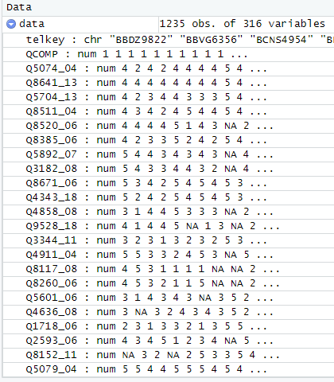
Determining Top Drivers in Small Organizations
2. Get input file
foreign::read.spss( here(“inputs”, “data.sav”) , to.data.frame = TRUE, use.value.labels = FALSE)
Notes:
This project reads an SPSS .sav dataset and a drivers csv from the inputs folder.
*** CLICK ***
- SPSS dataset with:
- QCOMP (0=non-respondent, 1=respondent)
- a single variable (called WU or ATRACKER1, etc.) that groups every case into a work unit
- pre-created drivers that match name in drivers.csv
- the questions underlying each driver (for reliability.test's alpha_stats)
- everything else is ignored

Slide 49
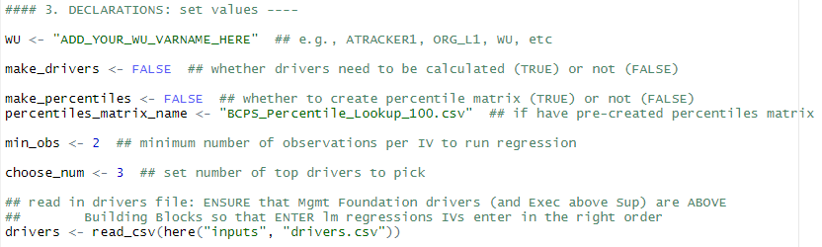
Determining Top Drivers in Small Organizations
3. Set organization-specific values
Build on set values and read-in data to create values needed for analyses: pull out names of variables for regressions and names of work units
Notes:
As seen in Steph’s presentation, to help with automation, the user sets values specific to their scenario.
*** CLICK 1 ***: There should be a variable in the data that assigns each employee to a sub-group (e.g., work unit). We need to call this variable throughout the script so we assign it a generic name, “WU”.
*** CLICK 2 ***: Even though we just read in a drivers file separate from the data, that did not contain driver scores. It was a mapping of what data results belong to which driver, what each driver’s name is, and other driver attributes (e.g., number of underlying questions, house level). Now we need to tell the script whether the data already contains driver scores (i.e., make_drivers <- FALSE). If it doesn’t have driver scores, the script needs to know to calculate them. We also need to know some other information. To determine which drivers are the most important for any given work unit, we need to know where that driver sits in its percentile distribution. We need to set a threshold of the minimum number of observations we require for each independent variable in the regressions.
*** CLICK 3 ***: Finally, we need to say how many top drivers we want.
- drivers.csv with columns names precisely (and in same order):
- driverID: short/ugly driver names (e.g., commit, Vision)
- Driver: nice driver names (e.g., Commitment; Vision, Mission & Goals)
- type: ENG, Roof, Foundation, Building Block (MUST be these names/case)
- num_qs: the number of underlying questions of the corresponding driver
- q1 - q#: (where q# is the max number of questions largest driver has)
- q1 - q#: QID of underlying question(s) of corresponding driver; one QID per column.
*** CLICK 4 ***: After we have set our declarations (organization-specific values), we use that information along with the data we have read in to pull out the names of the variables we will use in the regressions and the names of the work units.

Slide 50
Determining Top Drivers in Small Organizations
4. Call custom functions within a single script
Run various functions based on set values
if(make_drivers == TRUE) {…}
calc.means()
if(make_percentiles == TRUE) {… } else {…}
reliability.test()
regressions.stepwise()
sig.pos.IVs()
regressions.enter()
Notes:
*** CLICK ***
END SLIDE has example function, if asked.
See example function for “if(make_drivers == TRUE) {…}“.
calc.means() function gets means for specified driver; outputs Group, mean, driver
calc.percentiles() function gets percentiles for specified driver by specified interval
reliability.test() function runs alpha for every 2+ item driver and outputs by row to alpha_stats with driver, vars, std_Cronbach, new_std_Cronbach, item_total_corrs
regressions.stepwise() function runs the best-sized STEPWISE linear model (lm) regression on ENG for a specified WU. If WUvar = NULL, will run on all data and report as Group = OVERALL
* for each sub-group in turn, stepwise regression is run on engagement with all drivers of all model sizes (single driver, 2 drivers, 3 drivers, etc.), i.e., 13 models
* pull best model for each model size
* pull model where adjusted R2 is 0.03 better than model of one less IV
* repeat for every sub-group (i.e., work unit)
sig.pos.IVs() function gets name(s) of stepwise-identified significant positive Building Block drivers by WU.
regressions.enter() function runs enter linear model regressions (with management drivers first) by WU for individual non-roof drivers that were selected through stepwise regression and that have significant positive beta coefficients. However, if no significant IVs found by stepwise linear model regressions by WUs, instead it runs single enter regressions on building block IVs and pick “choose_num” (e.g., three) highest drivers. But, if there were too few observations to run stepwise, it doesn't do any regressions. It uses traditional method (percentiles and means) instead. Regardless, it binds results to lm_stats_stepwise and outputs as "lm_stats.csv".

Slide 51
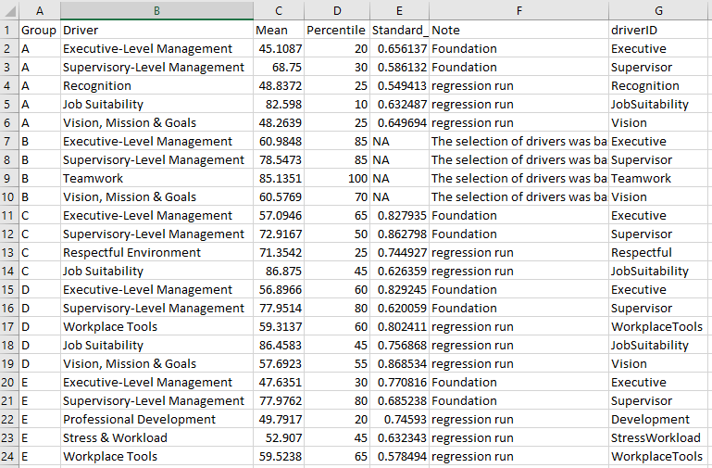
Determining Top Drivers in Small Organizations
5. Summarize results and save output as csv
Notes:
Key results are pulled together from means, percentiles, and linear regressions for the top drivers for each sub-group.
*** CLICK 1 *** You can see that the output was run on multiple sub-groups, in one go.
*** CLICK 2 *** For each group, the output provides the stats we need for the base drivers (“Management Drivers”) and then the top drivers, up to whatever maximum number we set in the beginning.

Slide 52
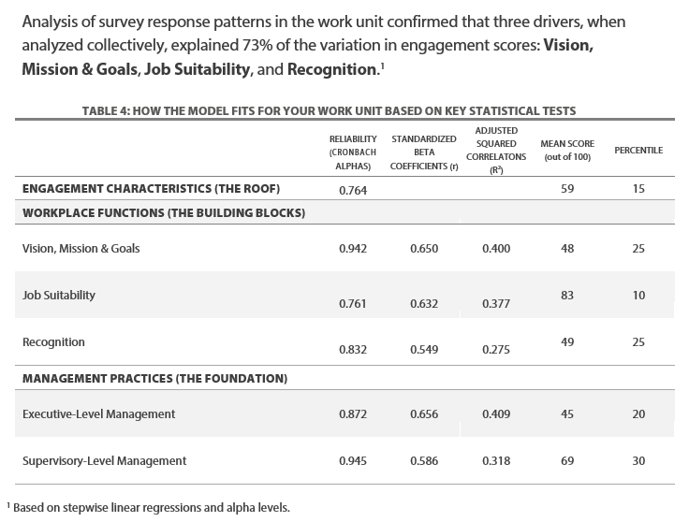
Summarized Results
Notes:
Then the user can write up the key info any way they need. This is one example.

Slide 53



Determining Top Drivers in Small Organizations
Benefits
SPSS is not cheap or user-friendly, R is
Multiple analyses can be run quickly
Results are reproducible
Notes:
For each sub-group (e.g., work unit), many analyses run:
calculate means and percentiles for every driver and Engagement (17 for 2018 WES Employee Engagement Model)
reliability tests: one for every driver (i.e., management, building blocks and roof) that has two or more underlying questions (14 for 2018 WES)
regressions: stepwise for every model size (based on number of non-roof drivers, 13 in 2018 WES model)
regressions: enter for management drivers and individual building blocks that were selected through stepwise regression process up to max number determined in set values step
** NOW MOVE TO 2nd CASE STUDY **
FREE: https://optimistaker.com/wp-content/uploads/2017/12/I-love-free-images.jpg
FAST: https://encrypted-tbn0.gstatic.com/images?q=tbn%3AANd9GcQCVvwKfiY0iv15REzEpWXQfRWBMD3BhihdijL5sKSelcebfLER
REPRODUCIBLE: https://encrypted-tbn0.gstatic.com/images?q=tbn%3AANd9GcRxL5YFKLqtMtEgyn3EHhPgEezu1MeRPLvQIyvV9Xrr8Ph6h9PP

Slide 54
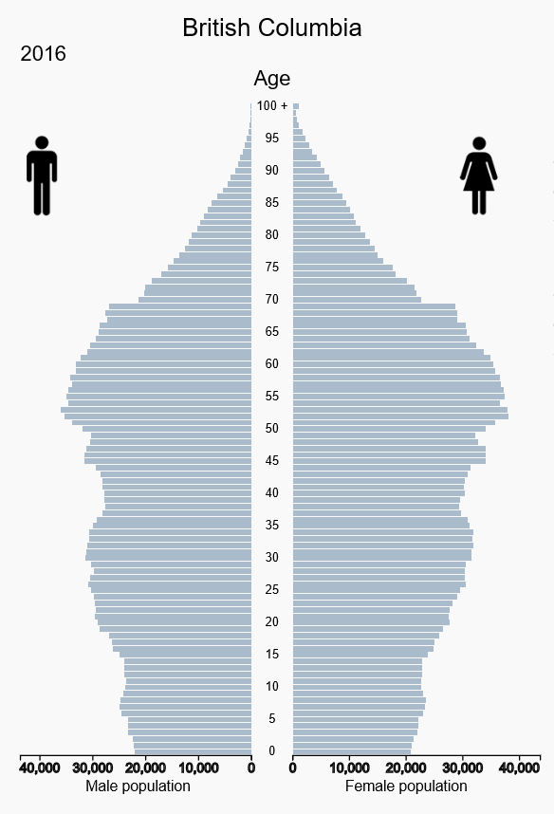
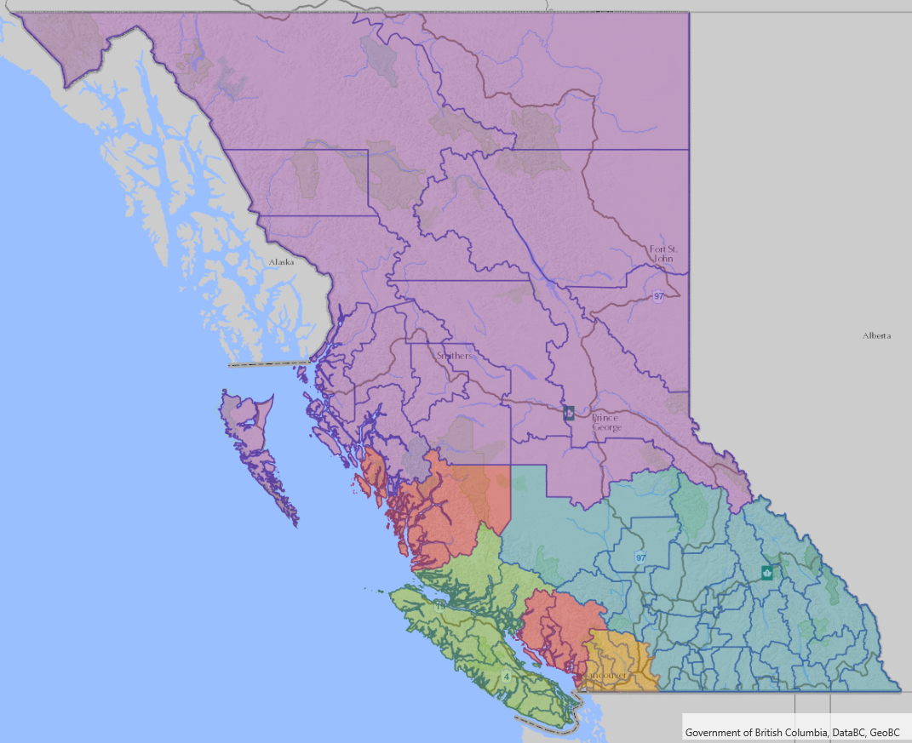
Raking Population Data
Notes:
Now I will talk about a completely different project: adjusting (“raking”) population counts by sex and age for various regions in BC.
BC population pyramid: https://www12.statcan.gc.ca/census-recensement/2016/dp-pd/pyramid/pyramid.cfm?type=1&geo1=01
LHA map: https://maps.gov.bc.ca/ess/hm/imap4m/, with Local Health Area layers

Slide 55
Raking Population Data
Problem
We know the age and sex population distribution for BC, but we often only know the overall population for regional sub-populations.
We can estimate those age and sex distributions and currently do so in APL, which few people know nowadays.
Notes:
So, what’s the problem with that?
*** CLICK 1 *** Population by age & sex is known for BC, but only population totals are known at sub-provincially, so…
*** CLICK 2 *** Rake estimates, but in an old programming language: APL
Some of you have probably heard of APL – show of hands?

Slide 56
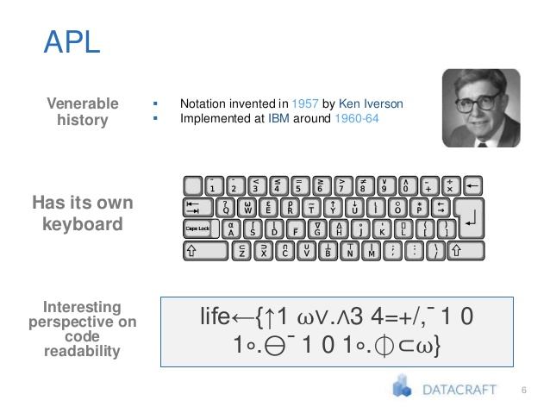
? ? ?
Notes:
APL stands for “A Programming Language”, and that is about all that I know about it!
*** CLICK 1 *** I googled “APL” and found this image.
*** CLICK 2 *** This is what really struck me!
We use APL at BC Stats to run the sub-provincial estimates and projections! See next slide for some code
https://www.slideshare.net/mikeranderson/clojure-for-data-science-57724240, slide 6

Slide 57
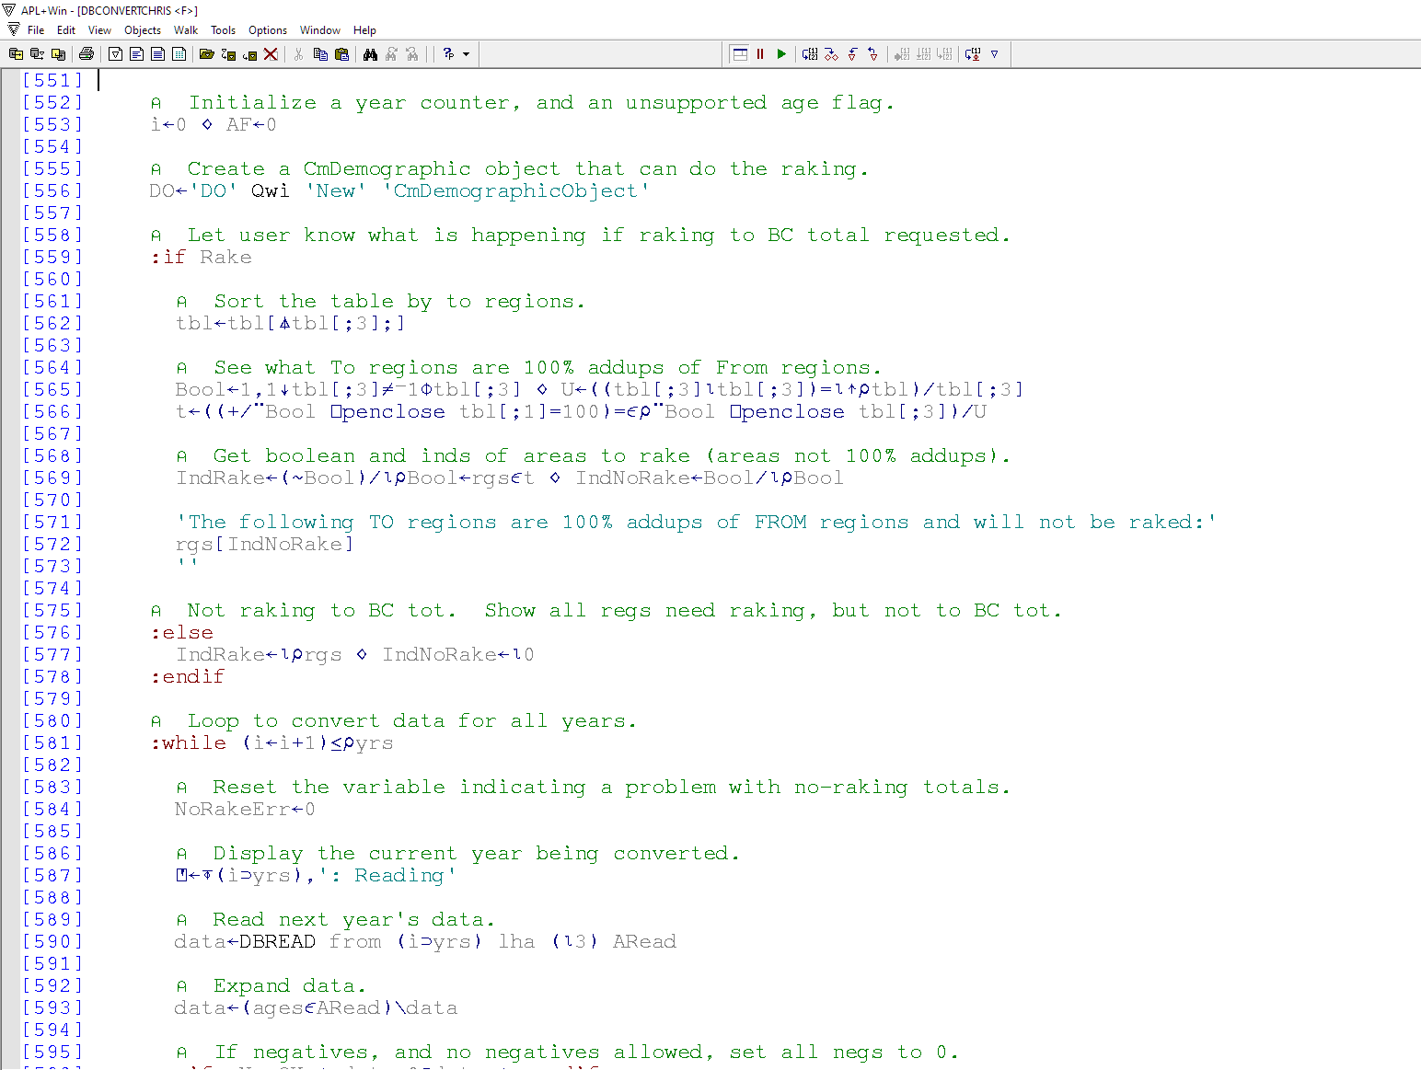
Some APL Raking Code
Notes:
This is an example of our raking code in APL.
** CLICK ***

Slide 58

Raking Population Data
Solution
Re-write the APL program in R, as more employees know R than those who know APL
Notes:
How do we solve this problem of raking population data without having to use APL?
*** CLICK ***

Slide 59
Raking Population Data
** R project **
Set raking values
Load packages and custom functions
Read input files
Call custom functions within a RUN_ALL script
Save output as csv
Notes:
The R project I created follows essentially the same process as I showed for determining the top drivers.

Slide 60
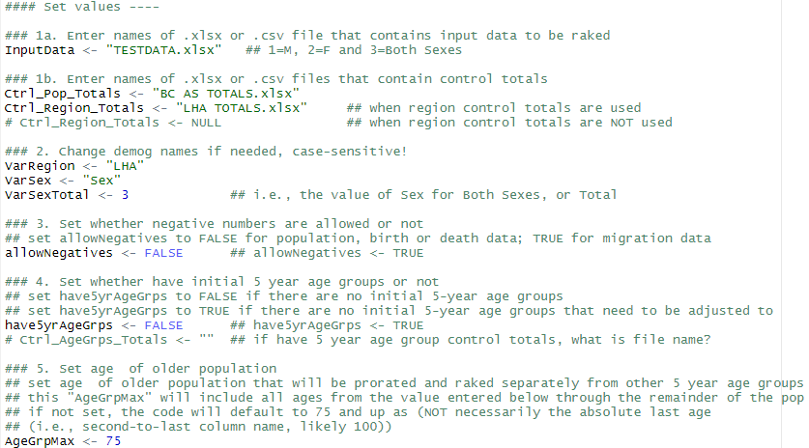
Raking Population Data
1. Set raking values
Notes:
Again, the user is asked to set values specific to their run of the code.
*** CLICK 1 *** We need to provide the files names of the input data that needs to be raked, and any control total files.
*** CLICK 2 *** We need to tell the script what our region and sex variables are called. The sex variable is numeric, and the largest number is the Total (i.e., Males + Females). We need to set that.
*** CLICK 3 *** We also need to tell the script whether we want negative population numbers to be allowed (yes for migration data, no for population data).
We need to tell the script whether we are providing aggregated 5-year age groups (e.g., 0-4, 5-9, etc.) and if so, that filename.
*** CLICK 4*** Finally, we often treat the older population separately from the rest so that they are not overly-raked. We can tell the script to use a certain age as the beginning of that cut-off, or it will default to 75 and up.

Slide 61
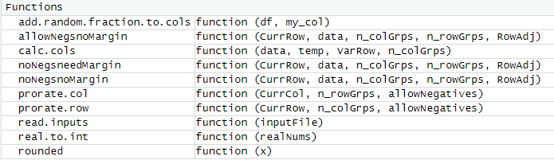
Raking Population Data
2. Load packages and custom functions
Load packages
library(here)
library(tidyverse)
library(openxlsx
Load custom functions
source(here("scripts", "00_functions.R"))
Notes:
The second step is to load the necessary packages *** CLICK 1 *** and the (10) custom functions I wrote *** CLICK 2 ***
library(here)
library(tidyverse) ## read_csv and str_detect
library(openxlsx) ## read.xlsx
You can also use require() and install.packages() to install packages if they aren’t already installed:
if (!require('here')) install.packages('here'); require('here’)

Slide 62
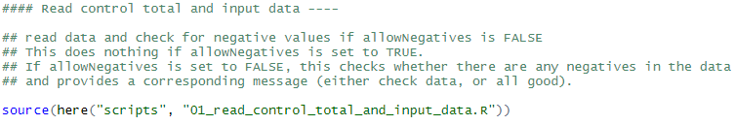
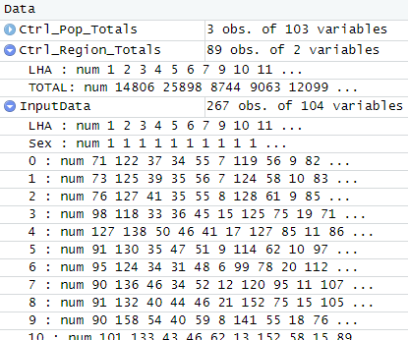
Raking Population Data
3. Read input files: data and control totals
Notes:
*** CLICK 1 *** I source a script that reads in the input data and any control totals based on the values that were set.
*** CLICK 2 *** For example, I read in population control totals for each sex and every single age, 0 through 99, and 100+.
*** CLICK 3 *** The regional control totals shown here has 89 LHAs. The input data has 267 observations (which is 89 LHAs * 3 sexes) for the single ages.

Slide 63
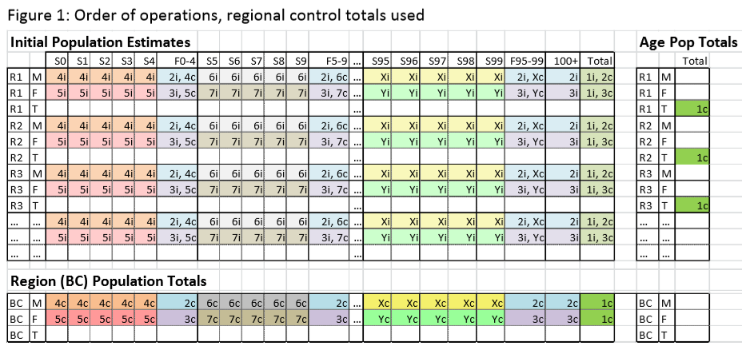
Raking Population Data
4. Call custom functions within a RUN_ALL script
Run 10 functions repeatedly over sex, ages and regions to prorate and rake data
Notes:
Once everything is loaded and the initial data is read in, the code calls the functions within a single script to …
*** CLICK 1 *** do some very complicated raking ….
*** CLICK 2 *** Essentially, the code runs the functions repeatedly for one sex at a time to adjust counts by age in regions so that everything sums up to the known control totals.
Functions range from simple ones like rounded() or read.inputs() to full-on raking:
rounded() function R rounds to even (i.e., 12.5 rounds to 12!) but we want to round to 0 (i.e., 12.5 rounds to 13)
read.inputs() function reads in xlsx or csv input files, detecting those file types from file extension
calc.cols() function calculates necessary columns: Sum, Ctrl_TOTAL, Diff, adj_value by calculating actual sum (of columns), adding in VarRow control totals, calculating the difference and calculating the adjustment value (difference divided by number of groups)
real.to.int() function converts real numbers (fractions) to integer numbers while preserving rounded sum
prorate.row() function to update initial estimates of row values. If the difference is NOT zero, adjust actual data. This is called for all rows one at a time (within “for” loop).
prorate.col() function to update initial estimates of column values. If the difference is NOT zero, adjust actual data. This is called for all columns one at a time (within “for” loop).
add.random.fraction.to.cols() function takes a dataframe (df), adds a random number to my_col, then determines row sort order based on my_col (with random fraction to break ties), and returns df without original my_col, but with sort_rows column with row sort order
allowNegsnoMargin() *raking* function is used when negative numbers are allowed
noNegsnoMargin() *raking* function is used when you need to subtract values from cells in current row, add to lower rows, negative numbers are not allowed
noNegsneedMargin() *raking* function is used when you need to add values to cells in current row, subtract from lower rows, and negative numbers are not allowed
The three *raking* functions deal with the details slightly differently depending on what is needed, but in general:
calc "whole people" adjustments to be made to all cells in the row
calc "residual people" adjustments to be made to selected cells in row
reconcile column control totals

Slide 64
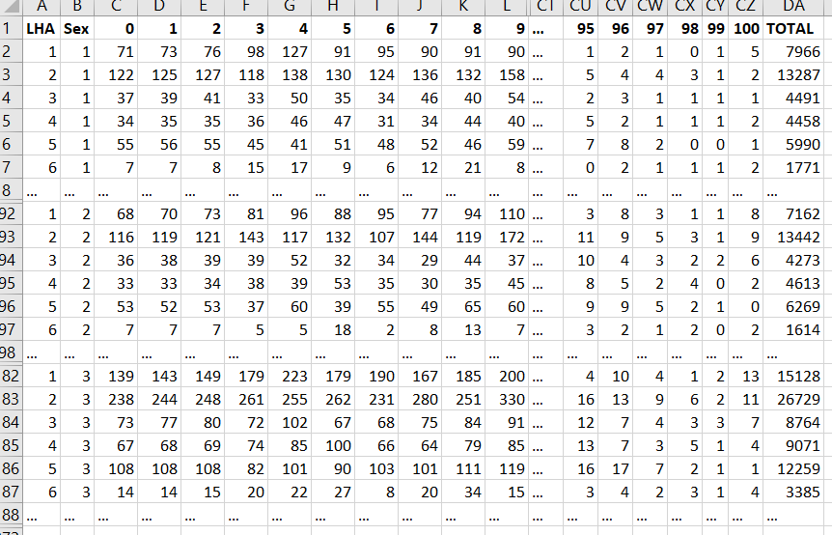
Raking Population Data
Our original input data
Notes:
Our input data had a region column “LHA”, followed by a “Sex” column, followed by 101 single age columns, and a “TOTAL” column. The first 89 data rows were for all LHAs for Sex = 1 (Males); this was followed by 89 rows for Sex = 2 (Females), and then for Sex = 3 (Total).
In the image above, I have hidden interim columns and rows to get a sense of the whole file.

Slide 65
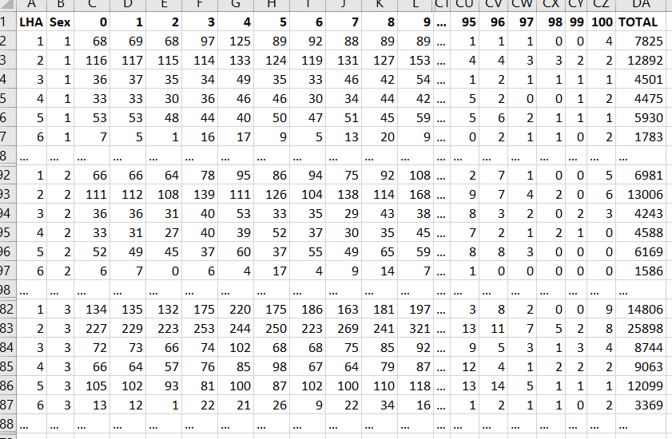
Raking Population Data
5. Save output as csv
Notes:
The raked output data is the same format as the input data and numbers are not very different, but now they all sum to BC control totals by age and sex, and each region by age and sex also sums to its corresponding control total.

Slide 66


Raking Population Data
Benefits
APL is a “lost language”; R’s popularity is growing quickly
Extremely complicated analyses can be run, and quickly
Again, results are reproducible
Notes:
*** CLICK 1 *** R popularity
*** CLICK 2 *** easy and fast
*** CLICK 3 *** reproducible
RISING: https://encrypted-tbn0.gstatic.com/images?q=tbn%3AANd9GcTPvTO99z2HxXqFDnpTdXyWeTUWQ73bo3y7Y8TNjL5rwDdhafVe
EASY: https://www.google.com/url?sa=i&url=https%3A%2F%2Fleadingwithtrust.com%2F2014%2F03%2F09%2F7-ways-to-make-it-easy-for-people-to-work-with-you%2F&psig=AOvVaw1YawXWF68F9eQO2g1bfelX&ust=1584199589793000&source=images&cd=vfe&ved=0CAIQjRxqFwoTCMiAmujhl-gCFQAAAAAdAAAAABAD
REPRODUCIBLE: https://encrypted-tbn0.gstatic.com/images?q=tbn%3AANd9GcRxL5YFKLqtMtEgyn3EHhPgEezu1MeRPLvQIyvV9Xrr8Ph6h9PP

Slide 67
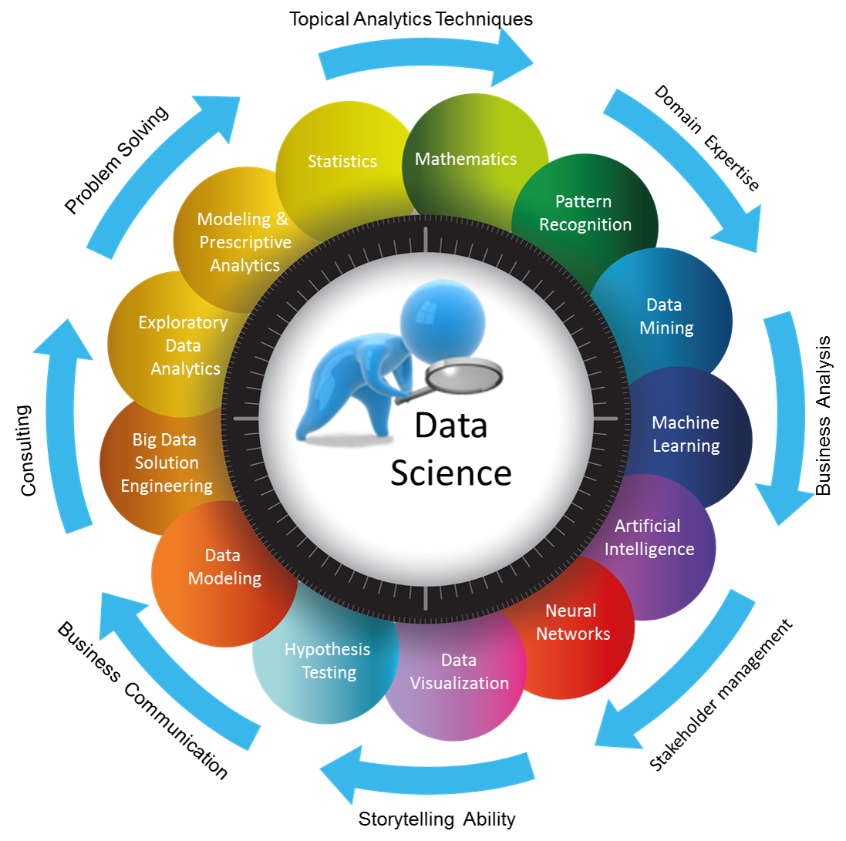
Summary
Data science is the intersection of multiple fields such as statistics and computer science, and allows us to analyze and communicate big data meaningfully.
R is an open source coding language that helps us with predictive analytics and data visualization, that is, “do data science”.
Notes:
I hope now you have some understanding of what it is that BC Stats does in terms of data science and R.
*** CLICK 1 *** Data science
*** CLICK 1 *** R
Abstract:
The motivations behind the use of R (including reproducibility and other strategies to make our workflow more robust),
Examples of the kinds of problems that a data scientist in the public service confronts, and
How those problems have been tackled.

Slide 68
Martin Monkman
Provincial Statistician & Director
BC Stats
martin.monkman@gov.bc.ca
250.216.5848
Stephanie Yurchak
Data Scientist
BC Stats
stephanie.yurchak@gov.bc.ca
250.480.8735
Julie Hawkins
Data Scientist
BC Stats
julie.hawkins@gov.bc.ca
250.812.1276

Slide 69


Slide 71
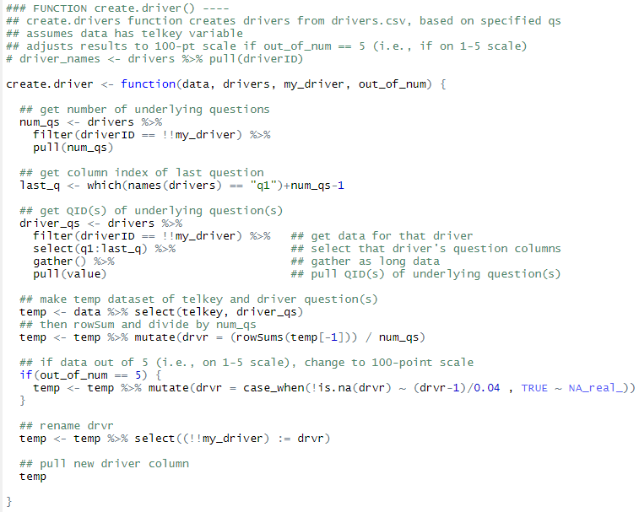
Example Function
Notes:
If “make_drivers” is set to TRUE, then the script uses the create.driver() function to do just that.
The functions arguments are a dataset “data”, the “drivers” file, specific driver to be calculated “my_driver”, and “out_of_num” which is the survey scale anchor.
The function gets the number of underlying questions for “my_driver” and saves it as “num_qs”.
The column index of the last question is saved as “last_q”.
The question IDs are pulled and saved as “driver_qs”.
A temporary dataset is created of just the respondent id (“telkey”) and the driver_qs.
The driver is calculated from R’s internal function, rowSums() divided by num_qs.
If the “out_of_num” is 5 (meaning a scale from 1 – 5), the driver is then converted to a score out of 100.
The driver result is renamed to match “my_driver”.
The properly named driver data is then pulled out as its own column of data.
This function is called within a larger set of code which (a) gets required driver names from drivers, (b) maps through the above function for each driver and attaches the resulting data to the main datafile, (c) runs the above function for the Engagement driver (with out_of_num = 100) and attaches that to the main datafile.

Slide 72
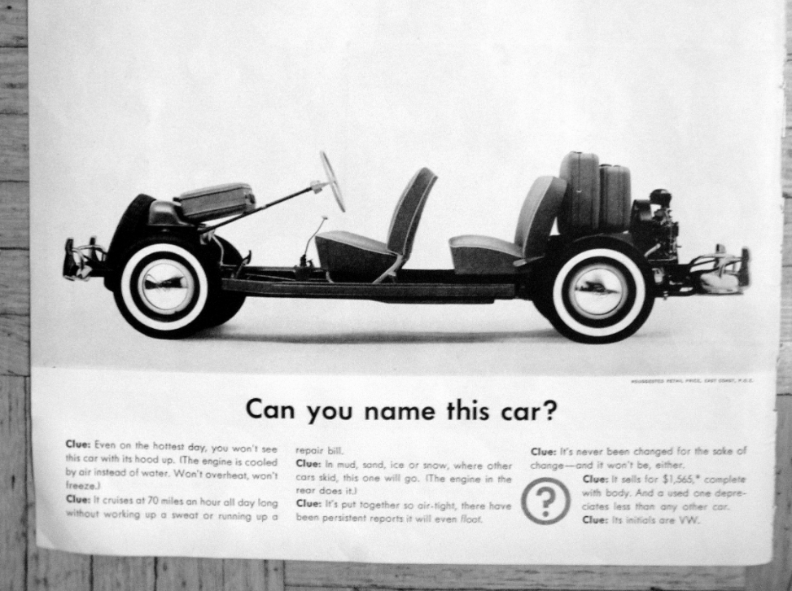
Notes:
Drew Conway, “The Data Science Venn Diagram” (2013-03-26)
http://drewconway.com/zia/2013/3/26/the-data-science-venn-diagram

Slide 73
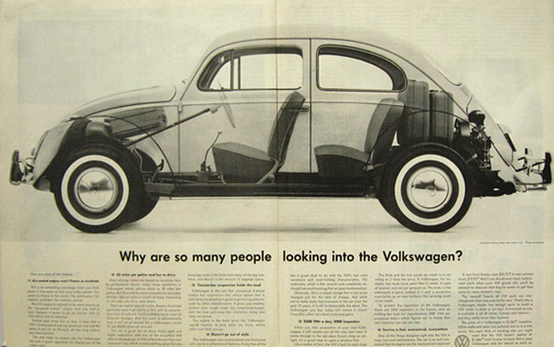
Notes:
Drew Conway, “The Data Science Venn Diagram” (2013-03-26)
http://drewconway.com/zia/2013/3/26/the-data-science-venn-diagram

Slide 74
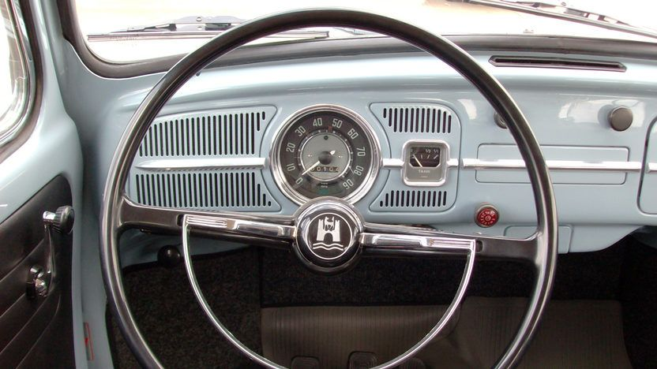
Notes:
Drew Conway, “The Data Science Venn Diagram” (2013-03-26)
http://drewconway.com/zia/2013/3/26/the-data-science-venn-diagram

Slide 75
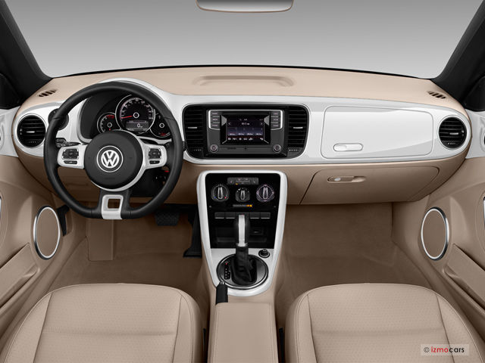
Notes:
Drew Conway, “The Data Science Venn Diagram” (2013-03-26)
http://drewconway.com/zia/2013/3/26/the-data-science-venn-diagram

Slide 76
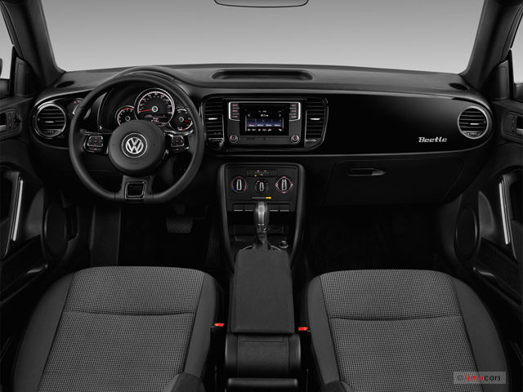
Notes:
Drew Conway, “The Data Science Venn Diagram” (2013-03-26)
http://drewconway.com/zia/2013/3/26/the-data-science-venn-diagram

Slide 77
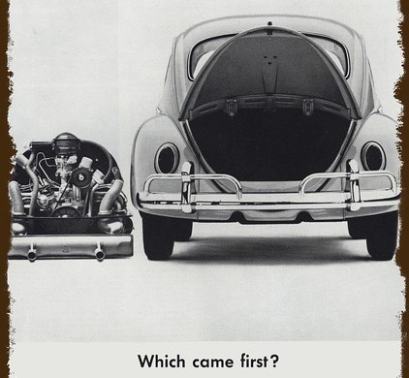
Notes:
Drew Conway, “The Data Science Venn Diagram” (2013-03-26)
http://drewconway.com/zia/2013/3/26/the-data-science-venn-diagram

